Slide 1




Asthma Prediction
Using ML and Smartphone application
TEAM 11:
Sabarinath
Shyam Ganesh
Sidesh Sundar
Sasank Sami
Bharadwaj

Slide 2
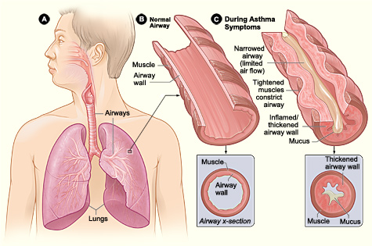
What is Asthma
Asthma is a condition in which your airways become:
Narrow
Swell
Produce extra mucus.
This makes breathing difficult
Notes:
This can make breathing difficult and trigger coughing, a whistling sound (wheezing) when you breathe out and shortness of breath.

Slide 3



Smyptoms
Shortness of breath
Chest tightness or pain.
Wheezing
Trouble sleeping
Coughing

Slide 4

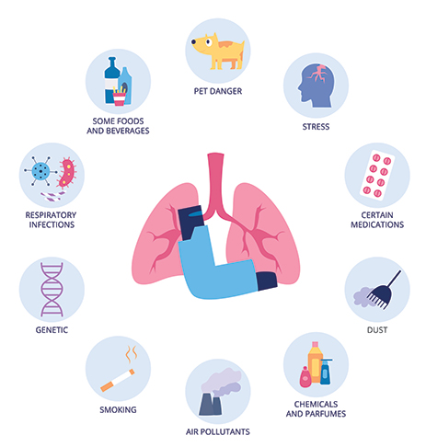
Causes
Tobacco Smoke
Dust Mites
Outdoor Air Pollution
Pests and pets
Mold ,cleaning and disinfection

Slide 5
Age Groups (Years) Characteristic Weighted Number With Current Asthma Percent (SE) | Age Groups (Years) Characteristic Weighted Number With Current Asthma Percent (SE) | Age Groups (Years) Characteristic Weighted Number With Current Asthma Percent (SE)
0–4 | 394,206 | 2.0 (0.43)
5–11 | 1,641,279 | 5.9 (0.58)
5–14 | 2,699,214 | 6.6 (0.55)
5-17 (School Age) | 3,832,453 | 7.2 (0.49)
12-14 (Young Teens) | 1,057,935 | 8.1 (1.10)
12-17 | 2,191,174 | 8.6 (0.77)
15-17 (Teenagers) | 1,133,239 | 9.1 (1.11)
15–19 | 1,833,105 | 9.3 (0.93)
11-21 (Adolescents) | 4,136,845 | 9.0 (0.63)
20–24 | 2,253,542 | 10.3 (1.05)
22-39 (Young Adults) | 6,621,732 | 8.5 (0.40)
25–34 | 3,600,545 | 8.1 (0.51)
35–64 | 10,245,123 | 8.3 (0.28)
65+ | 4,215,039 | 7.8 (0.34)

Slide 6
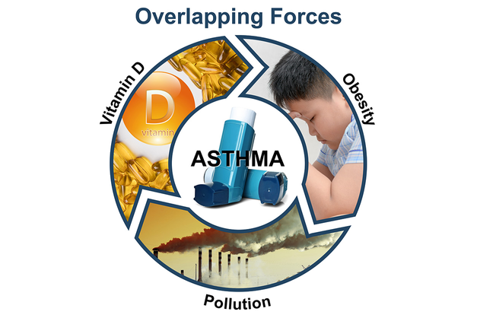
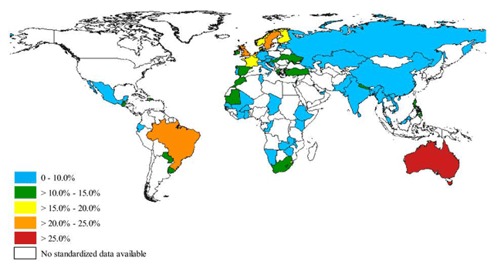
Environmental and geographical distraction
A wide range of indoor and outdoor allergens, irritants, as well as cold temperatures, can exacerbate asthma.
For some children, environmental allergies can trigger asthma symptoms or make them worse.
Household exposures to dust mites and cockroach allergens, and the irritant effects of environmental tobacco smoke, contribute significantly to asthma morbidity.
Countries with the highest prevalence of clinical asthma were Australia (21.5%), Sweden (20.2%), UK (18.2%), Netherlands (15.3%) and Brazil (13.0%); however, the US and Canada were excluded.
The lowest rates were observed in Vietnam (1.0%), Bosnia-Herzegovina (1.4%), and China (1.4%)

Slide 7
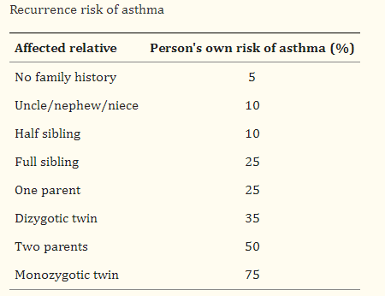
Genetic factors
There are different experimental approaches to establishing a connection between a gene and a disease such as asthma.
The two main options are genetic linkage analysis and genetic (allelic) association analysis.
The recurrence risk of asthma in children with one affected parent is around 25%, whereas the risk if both parents are affected is around 50%.
Reference:
https://www.ncbi.nlm.nih.gov/pmc/articles/PMC4629762/#:~:text=The%20recurrence%20risk%20of%20asthma,close%20relative%20with%20the%20disease.

Slide 8
Binary output
Logistic Regression
live
Asthma attack prediction
Linear Regression
Neural Network
Algorithms used in general (2010-2022)
Historical data
Stages
Decision Trees
Naive Bayes
factors
Classification
environmental
Genetic

Slide 9
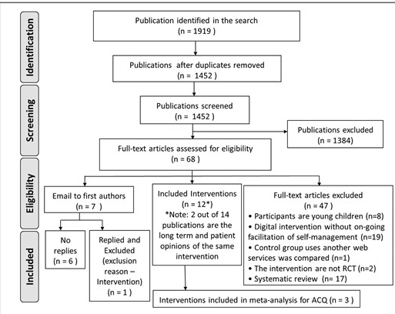
Biomarkers of type 2 inflammation include:
Sputum
Blood eosinophils,
Exhaled nitric oxide levels
Serum periostin.

Slide 10
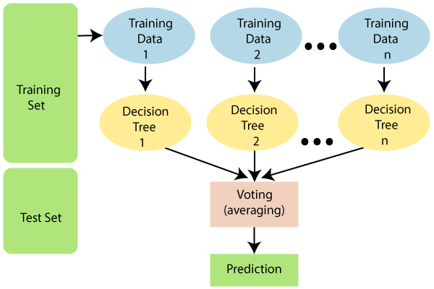
Random Forest
Random forest is used on the job by data scientists in many industries including banking, stock trading, medicine, and e-commerce.
It's used to predict the things which help these industries run efficiently, such as customer activity, patient history, and safety.
Random forest algorithms have three main hyperparameters, which need to be set before training.
These include node size, the number of trees, and the number of features sampled.
From there, the random forest classifier can be used to solve for regression or classification problems.

Slide 11
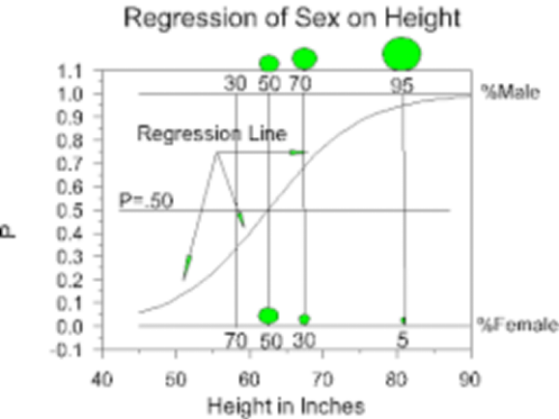
Logistic regression
This type of statistical model (also known as logit model) is often used for classification and predictive analytics.
Logistic regression estimates the probability of an event occurring, such as voted or didn’t vote, based on a given dataset of independent variables.
Since the outcome is a probability, the dependent variable is bounded between 0 and 1.
In logistic regression, a logit transformation is applied on the odds—that is, the probability of success divided by the probability of failure.

Slide 12
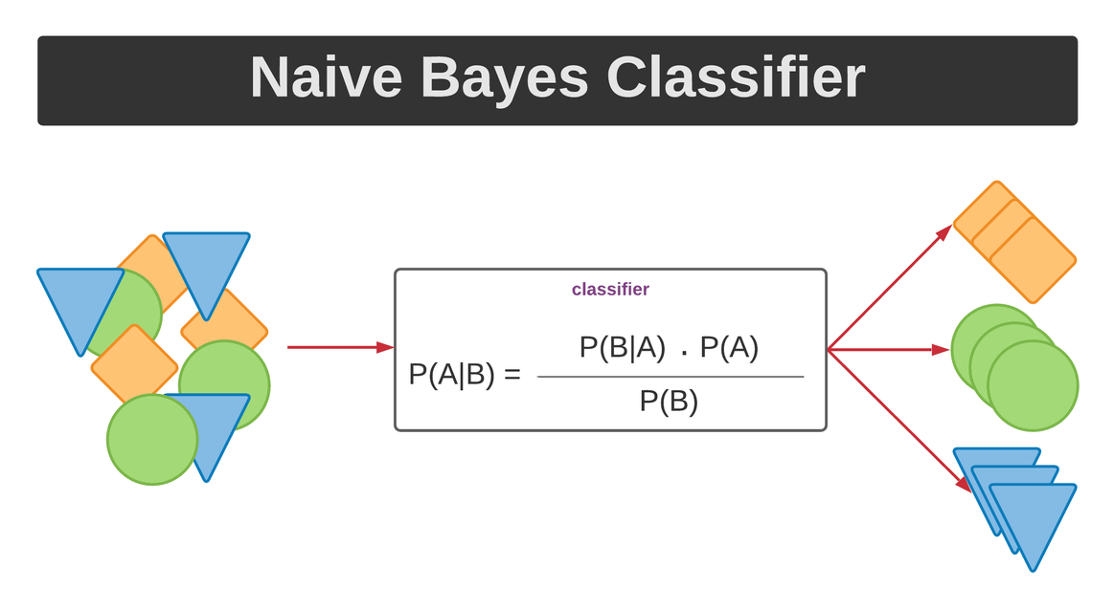
Naive Bayes
Naive Bayes classifiers are a collection of classification algorithms based on Bayes’ Theorem.
It is not a single algorithm but a family of algorithms where all of them share a common principle, i.e. every pair of features being classified is independent of each other.
The dataset is divided into two parts, namely, feature matrix and the response vector.
Feature matrix contains all the rows of dataset in which each vector consists of the value of dependent features.
Response vector contains the value of class variable for each row of feature matrix.
The fundamental Naive Bayes assumption is that each feature makes an:
independent
equal

Slide 13
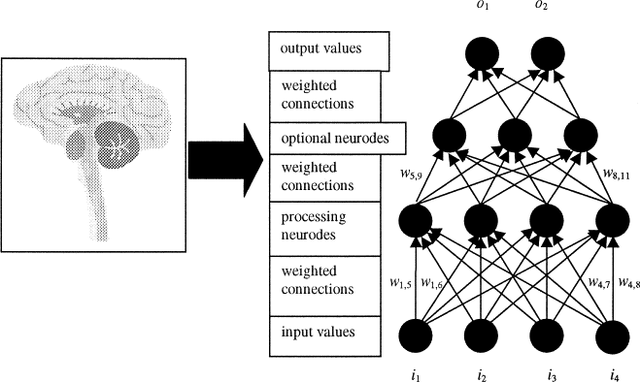
ANN
Artificial neural network (ANN) is a computational model that consists of several processing elements that receive inputs and deliver outputs based on their predefined activation functions.
They are multi-layer fully-connected neural nets that look like the figure below.
They consist of an
input layer,
multiple hidden layers,
output layer.
Every node in one layer is connected to every other node in the next layer.
ANNs are efficient data-driven modelling tools widely used for nonlinear systems dynamic modelling and identification.

Slide 14
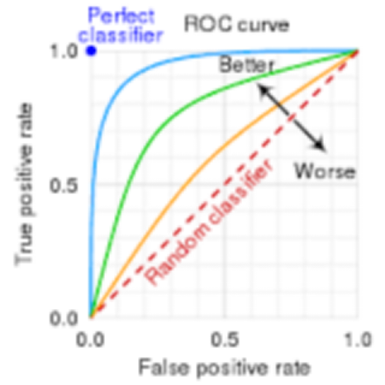
ROC - Curve
An ROC curve (receiver operating characteristic curve) is a graph showing the performance of a classification model at all classification thresholds.
This curve plots two parameters:
True Positive Rate.
False Positive Rate
True Positive Rate (TPR) is a synonym for recall and is therefore defined as follows:
TPR=TPTP+FN
False Positive Rate (FPR) is defined as follows:
FPR=FPFP+TN
An ROC curve plots TPR vs. FPR at different classification thresholds.

Slide 15






Extract the data from the data source.
Classify and extract thee common features and group the data.
Methodology
Now train and test the data in 7:3 ratio.
These data are splited to increase the efficiency and computational speed.
Then the trained data is subjected to analysis and cross validation.

Slide 16
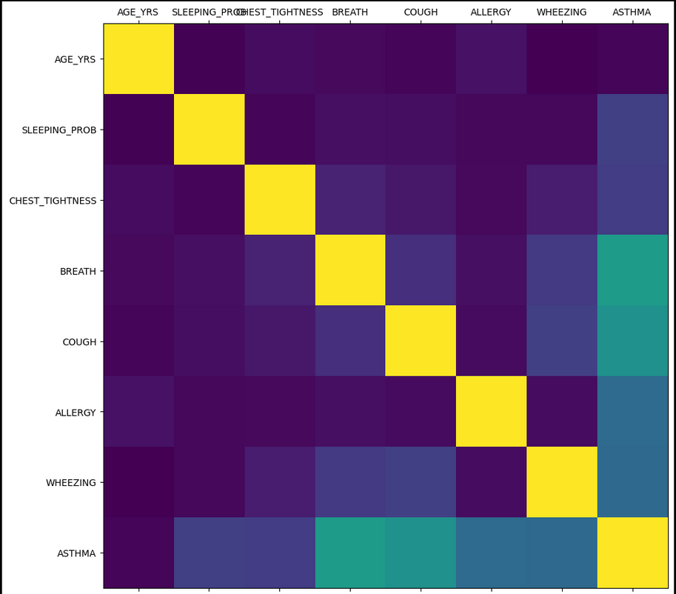
Input classification
and correlation

Slide 17
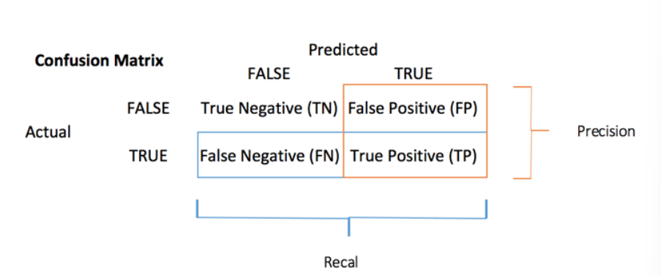
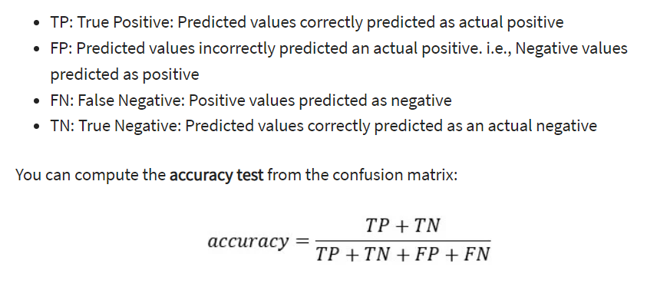
Confusion matrix

Slide 18
The correlation matrix in excel summarizes the correlation data in a tabular form.
It displays the correlation coefficients which measure the relationship between two or more variables. The “correlation” option of the “data analysis” tab helps create a correlation matrix
Correlation assesses the dependency of one variable on the other.
It shows how the impact of an increase or a decrease in one variable affects the other.
In multiple correlation, more than two variables are studied at the same time.
we use correlation graph as a part of data pre-processing.
Correlation
Graph

Slide 19
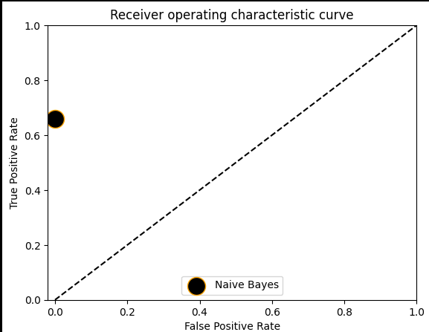
Naive Bayes

Slide 20
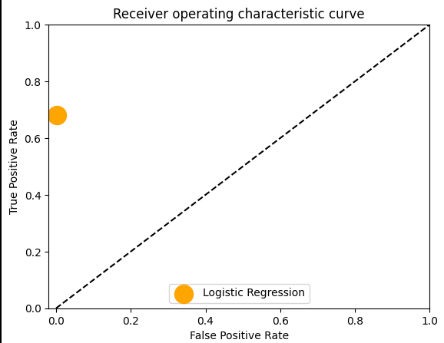
Logistic regression

Slide 21
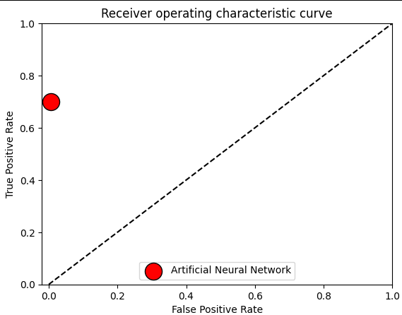
ANN

Slide 22
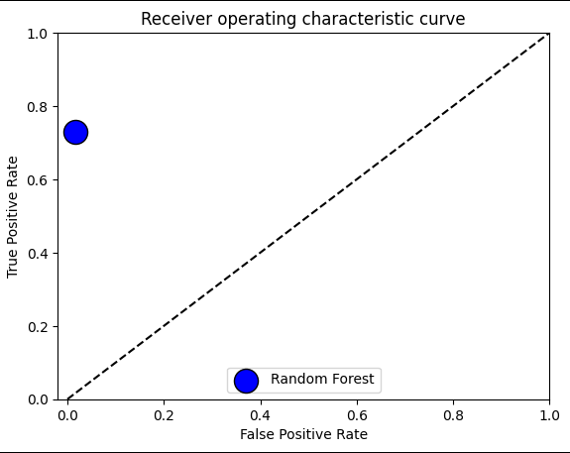
Random Forest

Slide 23
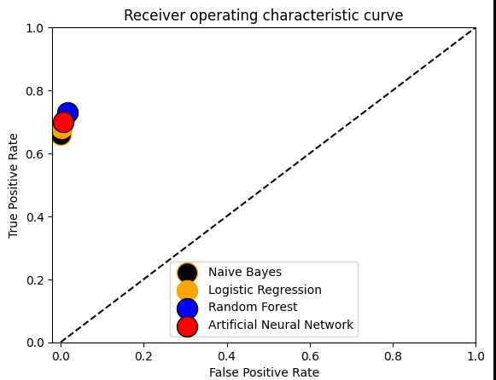
Final output
The result is displayed as a graphical representation

